Slide 1





Traffic Sign Detection using Transformer
Prepared by :
20CE126 - Hardi Shah Guided by :
20CE130 - Krima Shah Deepkumar Kothadiya
20CE133 - Prachi Shah
Slides 01

Slide 2
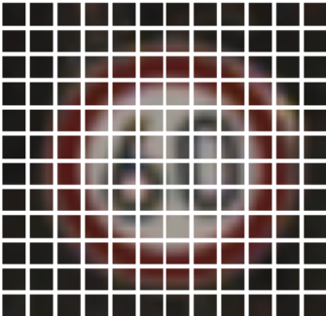
Table of Content
What is Traffic Sign Detection?
Why Transformer for traffic sign Detection?
Motivation
ViT Module
Objective
Working of Vision Transformer
Introduction
Result
Transformer
References
Slides 02

Slide 3
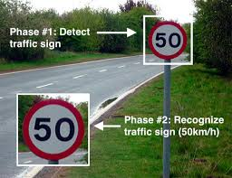
What is Traffic Sign
Detection?
Traffic-sign Detection is a technology by which an automated vehicle is able to detect the traffic signs put on the road.
For example, speed limit ,bump ahead, Railway crossing, etc.
It uses image processing techniques to detect the traffic signs.
Traffic signs can be analyzed using forward-facing cameras in many modern cars, vehicles and trucks.
Modern traffic-sign detection systems are being developed using Machine Learning, Deep Learning, Vision transformers, etc.
Slides 03

Slide 4

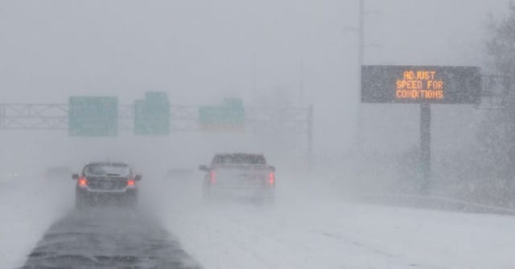
Motivation
In current traffic management systems, there is a high probability that the driver may miss some of the traffic signs on the road because of overcrowding due to neighbouring vehicles. With the continuous growth of vehicle numbers in urban agglomerations around the world, this problem is only expected to grow worse.
A visual-based traffic sign recognition system can be implemented on the an automobile with an aim of detecting and recognizing all emerging traffic signs. The same would be displayed to the driver with alarm-triggering features if the driver refuses to follow the traffic signs.
Slides 04

Slide 5
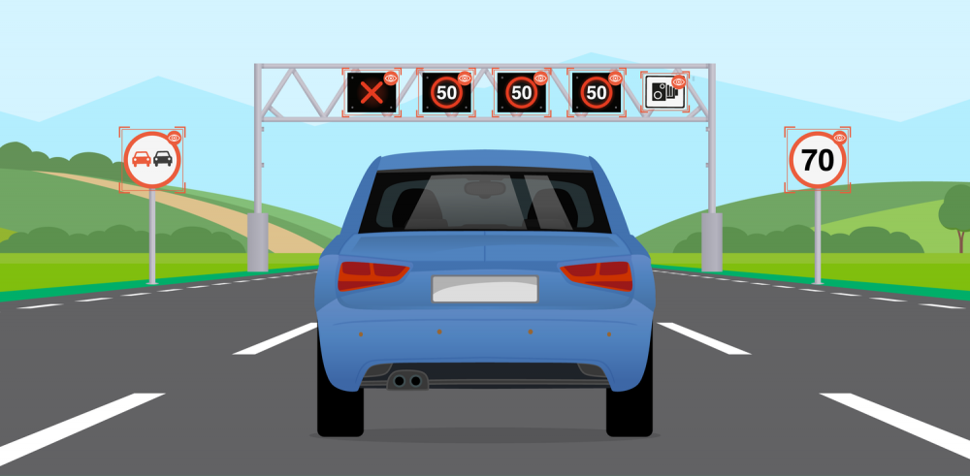
Objective
Driver can easily manage
An automated car should detect any sign board present on the road by live camera.
To find the locations and sizes of traffic signs in natural scene images.
Aim
Achieve good accuracy by using deep learning and machine learning technology.
Slides 05

Slide 6
Introduction
Traffic Sign Detection is used to display the speed limit signs, Bump ahead, Railway Crossing, etc.
Modern traffic-sign detection systems are being developed using Machine Learning, Deep Learning, Vision transformers, etc.
One of the basic use cases of a traffic-sign detection system is for speed limits.
For this purpose we used transformer model and under that we used Vit module.
ViT is abbreviated form of vision transformers.
More information about ViT and Transformer will be explained in upcoming slides.
Slides 06

Slide 7
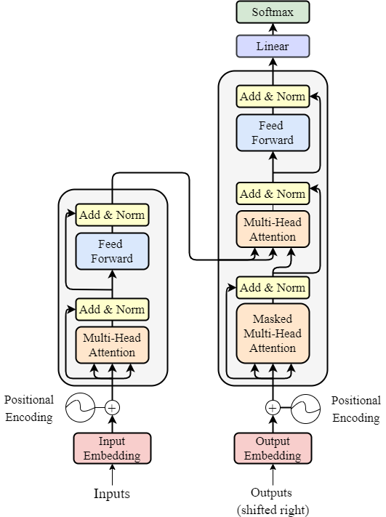
Transformer
Transformer is proved to be a simple and scalable framework for computer vision tasks like image recognition, classification, detection and segmentation, or just learning the global image representations. It demonstrated significant advantage in training efficiency when compared with traditional methods.
Transformer is Seq2Seq model, it has an encoder and a decoder.
Transformer is based on attention and self-attention.
Slides 07

Slide 8

Why Transformer for Traffic Sign Detection?
Transformer is very sufficient for large scale data.
ViT demonstrates excellent performance when trained on sufficient data.
Vision Transformer(ViT) can achieve excellent results with pure transformer architecture applied directly to a sequence of image patches for classification tasks.
Slides 08

Slide 9
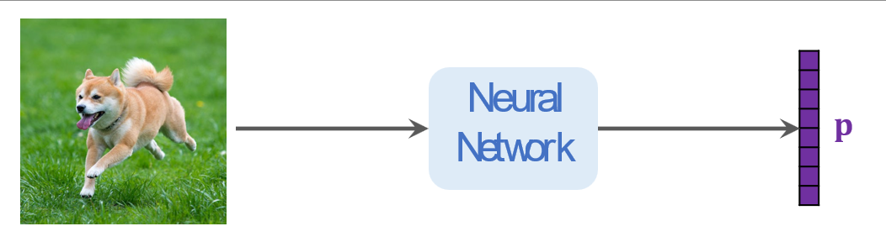
Vision Transformer (Vit)
Transformer was developed in 2017 for natural languague processing. ViT is succesfull appication of transformer in computer vision but vit model does not have novelty .ViT is exactly the encoder network of transformer.
Its is new state of image classification
Its accuracy surpasses the best convolutional new networks.
Slides 09

Slide 10

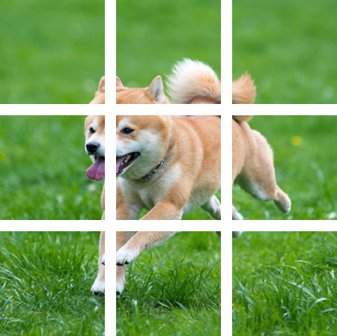
Working of Vision Transformer
Split image into patches
Here, the patches do not overlap.
User specifies :
patch size, e.g., 16x16
stride, e.g., 16x16 .
Slides 11

Slide 11
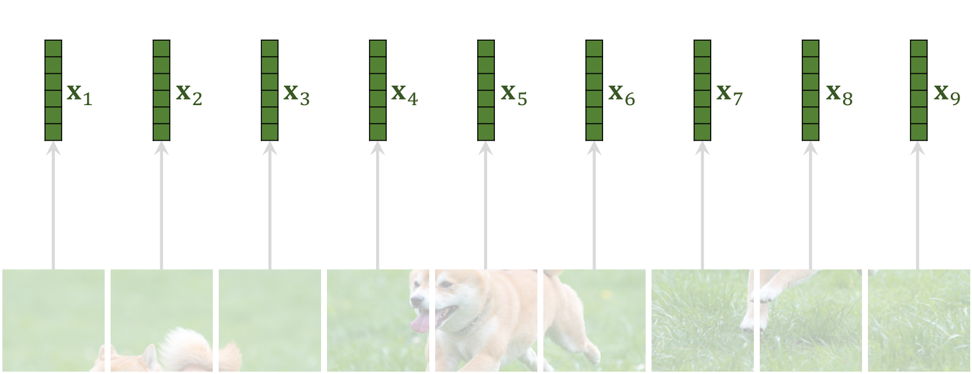
Vectorization
Slides 12

Slide 12
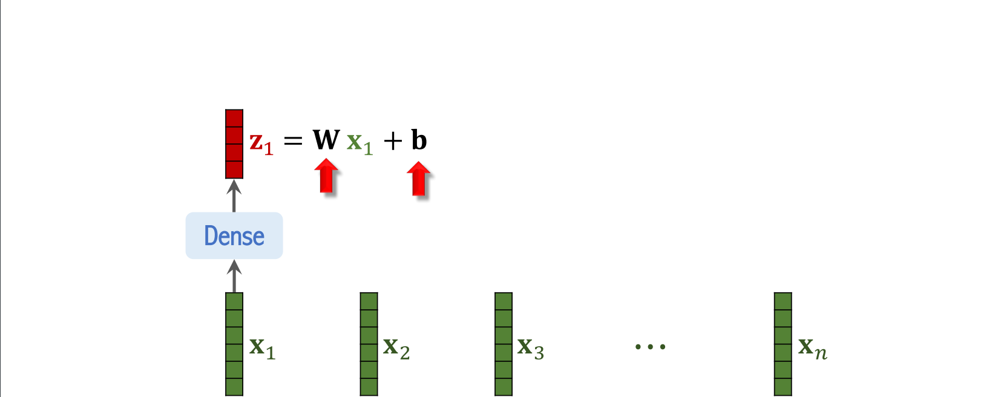
Applying dense layer
Aim
Slides 13

Slide 13
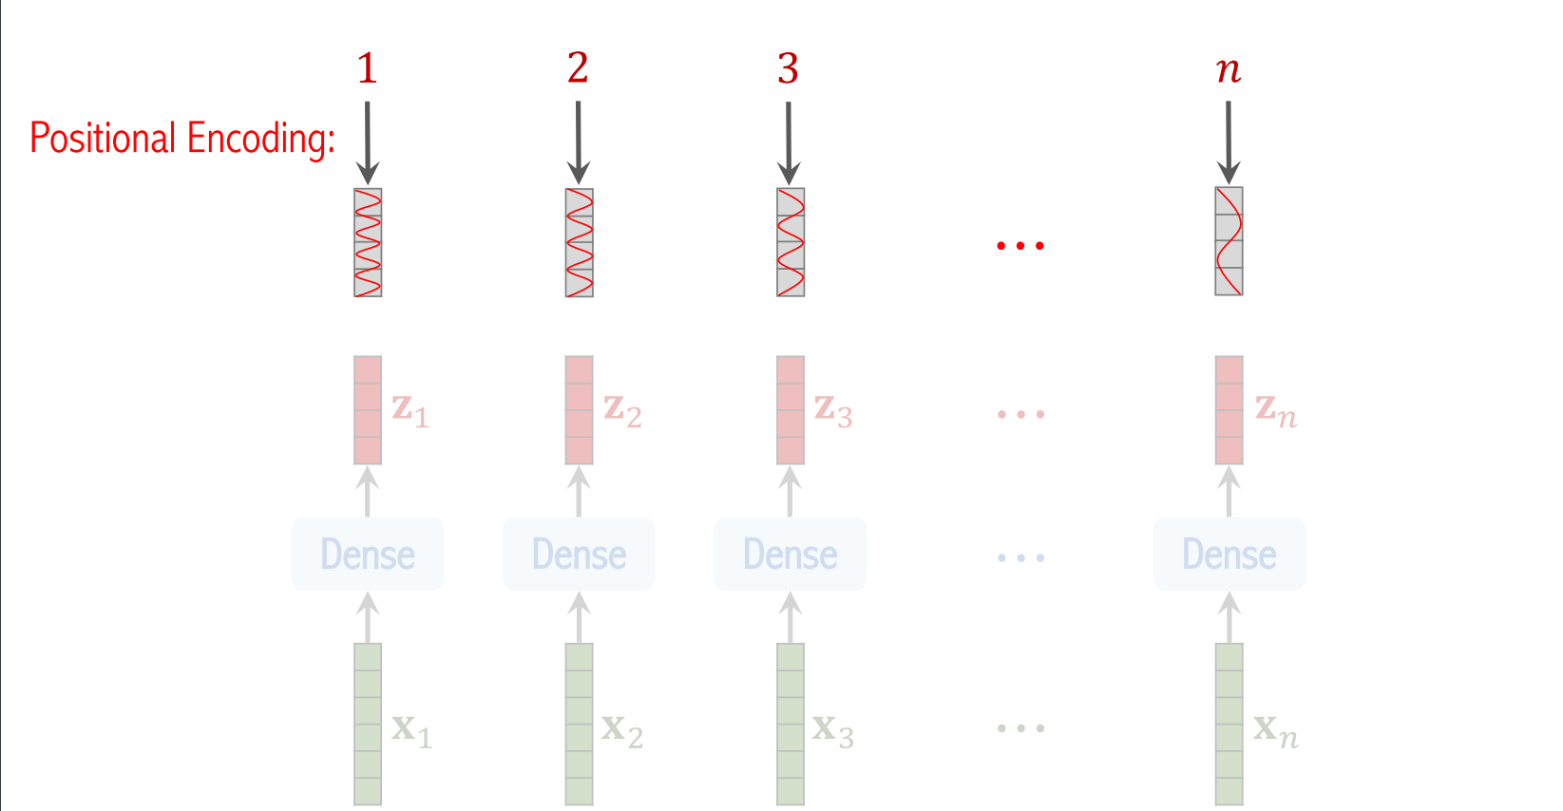
Add positional encoding
Slides 14

Slide 14
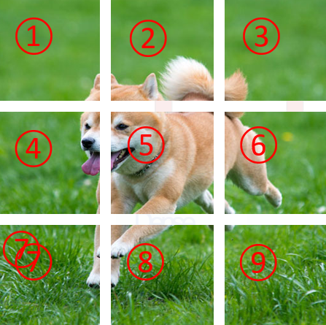

Need of positional encoding
Slides 15

Slide 15
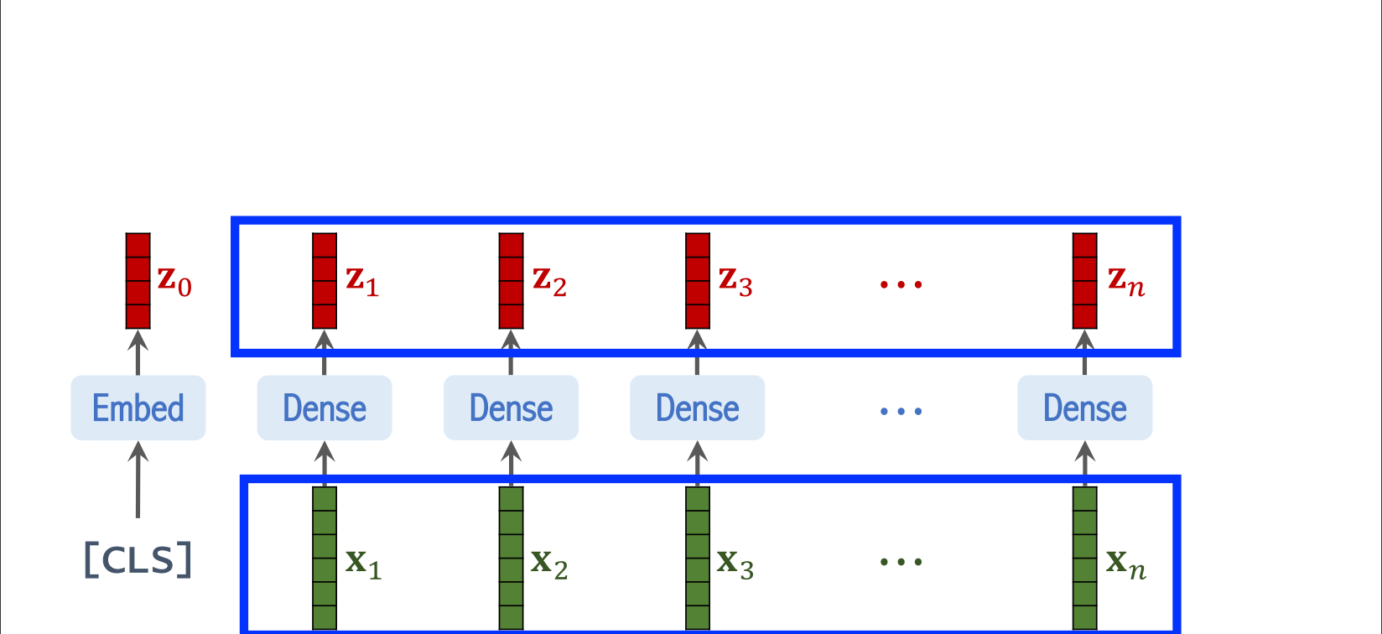
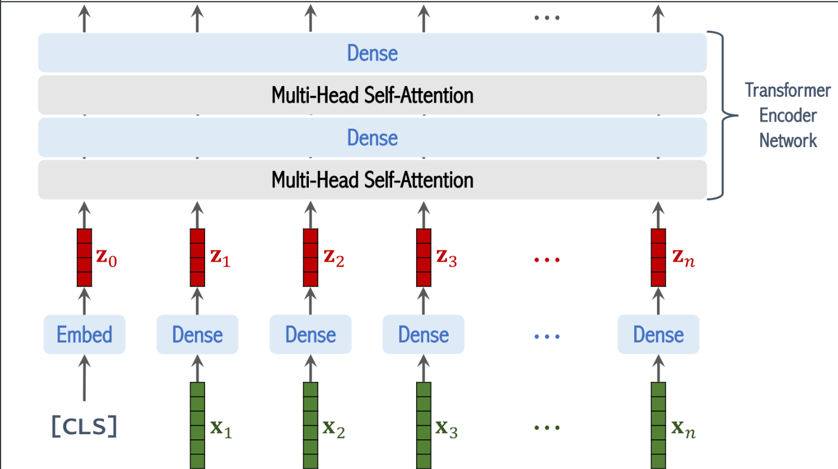
Slides 16

Slide 16
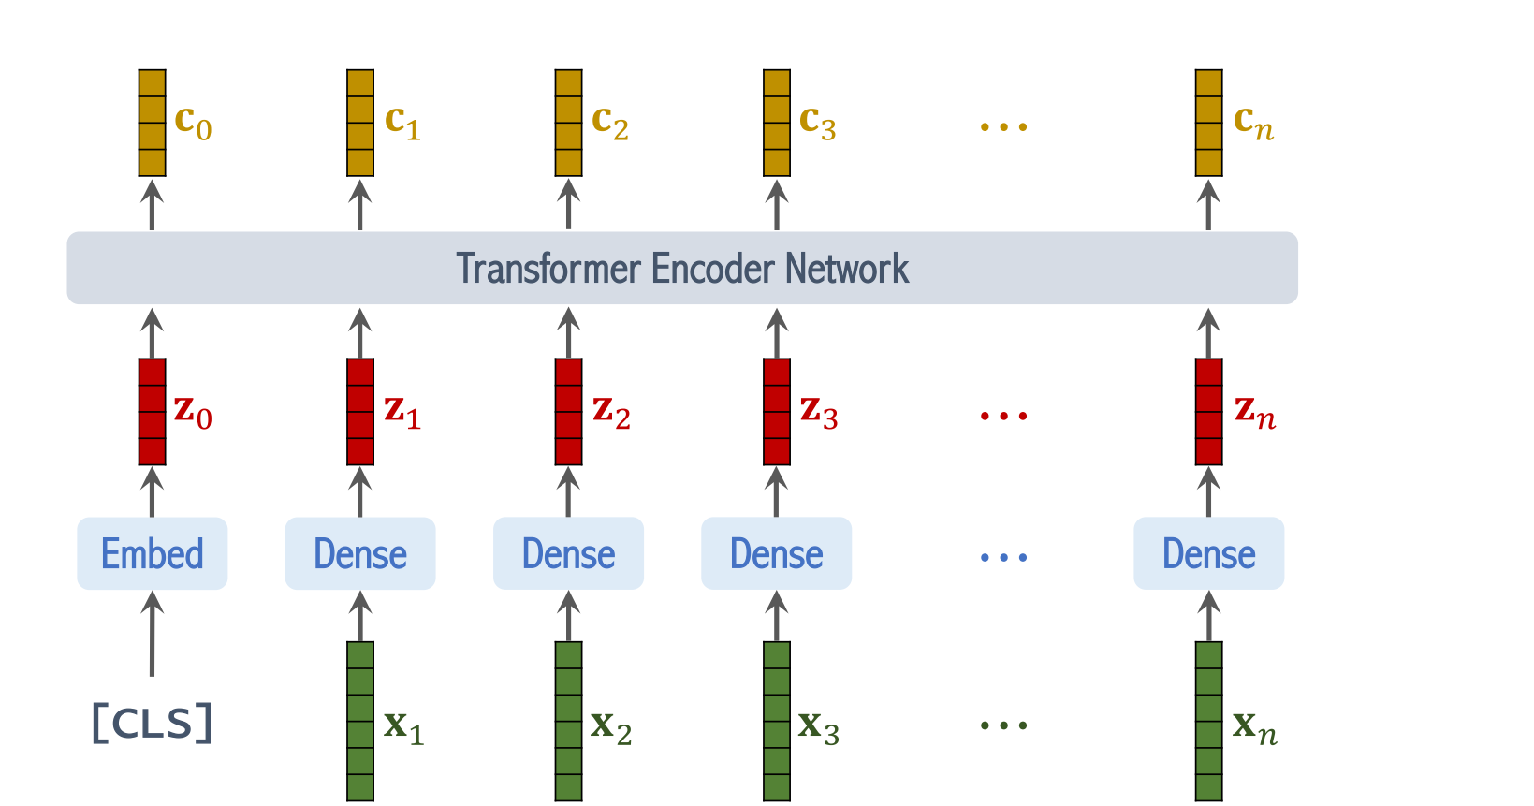
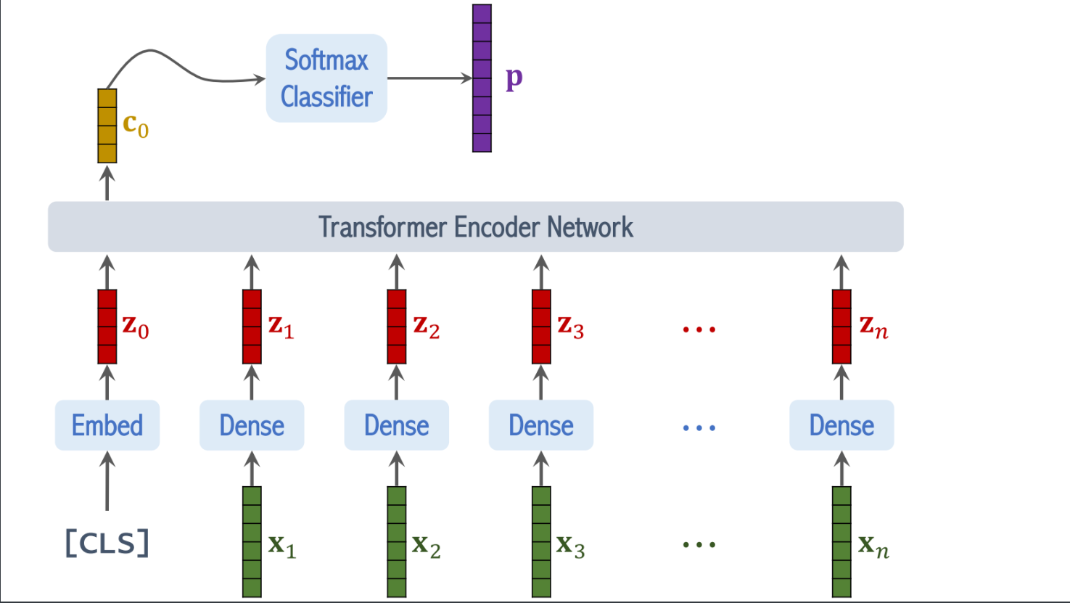
Slides 17

Slide 17
Image Classifications
CNNs, e.g., ResNet, were the best solutions to image classification.
Vision Transformer (ViT) beats CNNs (by a small margin), if the dataset for pretraining is sufficiently large (at least 100 million images).
Pretrained on ImageNet (small), ViT is slightly worse than ResNet.
Pretrained on JFT (large), ViT is slightly better than ResNet.
Pretrained on ImageNet-21K (medium), ViT is comparable to ResNet.
https://www.youtube.com/watch?v=HZ4j_U3FC94&t=423s
Slides 19

Slide 18
Literature Surveys
1.) Study on Traffic Sign Recognition
Mohamed Yusof Radzak, 2015
https://www.arcjournals.org/pdfs/ijrscse/v2-i6/6.pdf
2.) Recognization of Traffic Sign
Sayed Omar Sadat, Vishalkumar Pal, Kshitij Jassal, 2019
https://www.researchgate.net/publication/344379511_RECOGNIZATION_OF_TRAFFIC_SIGN
3.) An Automatic Traffic Sign Detection and Recognition System Based on Colour Segmentation, Shape Matching, and SVM
Mahammad Hannan, Aini Hussain, Salina Samad
https://www.hindawi.com/journals/mpe/2015/250461/
4.) Deep Neural Network for Traffic Sign Recognition Systems : Ananalysis of Spatial Transformers and Stochastic Optimization Methods
Alvaro Across Garcia, Juan A. Alvarez Garcia, Luis M. Soria-Morillo, 2018
https://www.researchgate.net/publication/322839466_Deep_neural_network_for_traffic_sign_recognition_systems_An_analysis_of_spatial_transformers_and_stochastic_optimisation_methods
.
Slides 20

Slide 19
Model Parameters
learning_rate = 0.001
weight_decay = 0.0001
batch_size = 256
Classes = 5
num_epochs = 30
image_size = 72 * 72
patch_size = 6 * 6
projection_dim = 64
num_heads = 4
transformer_layers = 8
Slides 21

Slide 20
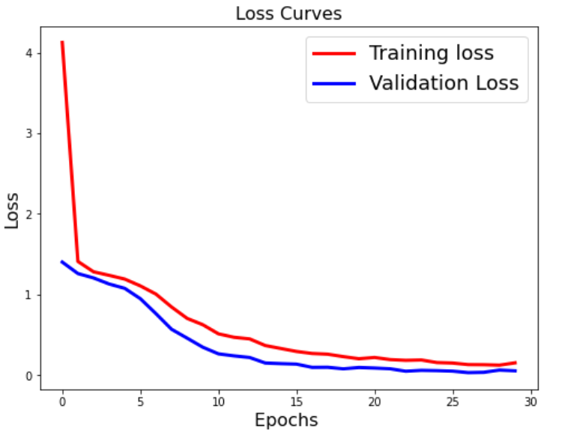
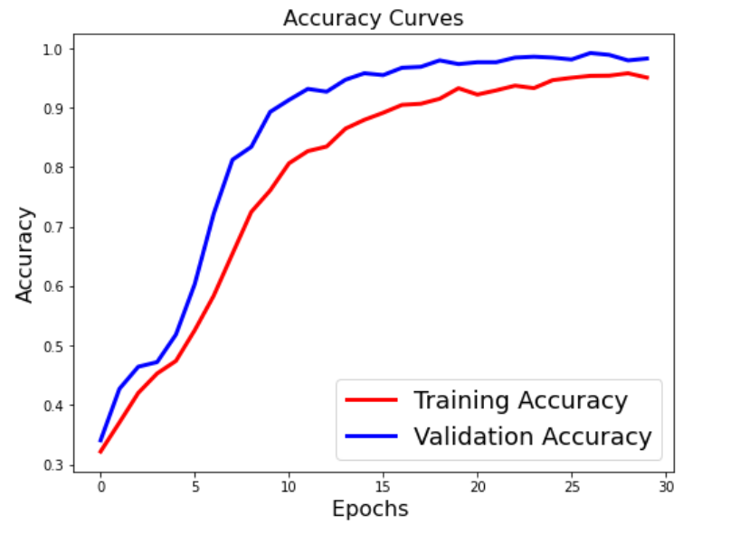
Result
Daniel Gallego
Co-Founder
Test accuracy: 98.7%
Test top 5 accuracy: 100.0%
Slides 22

Slide 21
References
https://thesai.org/Downloads/Volume7No1/Paper_93-Traffic_Sign_Detection_and_Recognition.pdf
https://www.hindawi.com/journals/mpe/2015/250461/
https://medium.com/inside-machine-learning/what-is-a-transformer-d07dd1fbec04
https://www.britannica.com/technology/transformer-electronics
https://theaisummer.com/transformer/
https://www.researchgate.net/publication/322839466_Deep_neural_network_for_traffic_sign_recognition_systems_An_analysis_of_spatial_transformers_and_stochastic_optimisation_methods
https://www.kaggle.com/datasets/meowmeowmeowmeowmeow/gtsrb-german-traffic-sign
https://www.researchgate.net/publication/344379511_RECOGNIZATION_OF_TRAFFIC_SIGN
Aim
Slides 23

Slide 22
THANK YOU
Slides 24

